Slide 1
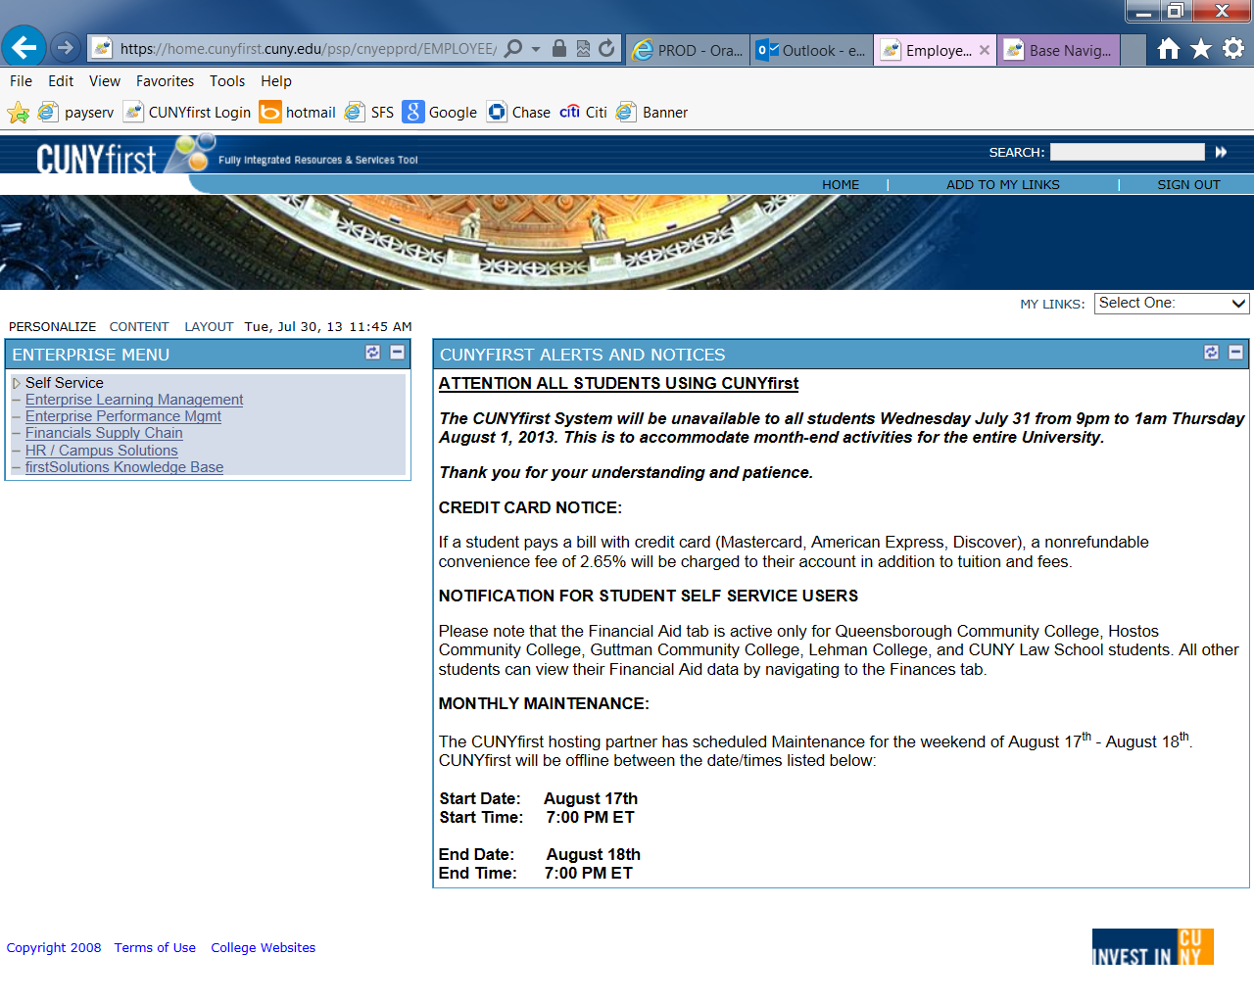
Running Department Expenditure Detail Reports
Click “Financials Supply Chain”

Slide 2
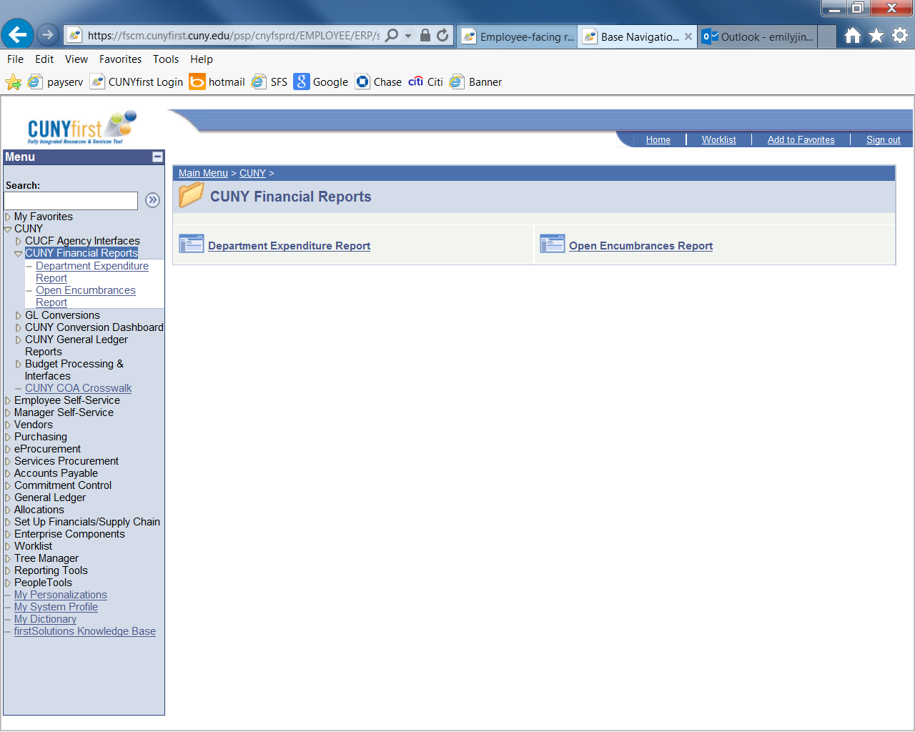
Running Department Expenditure Detail Reports
Navigation:
CUNY
2. CUNY Financial Reports
3. Click “Department Expenditure Report”

Slide 3
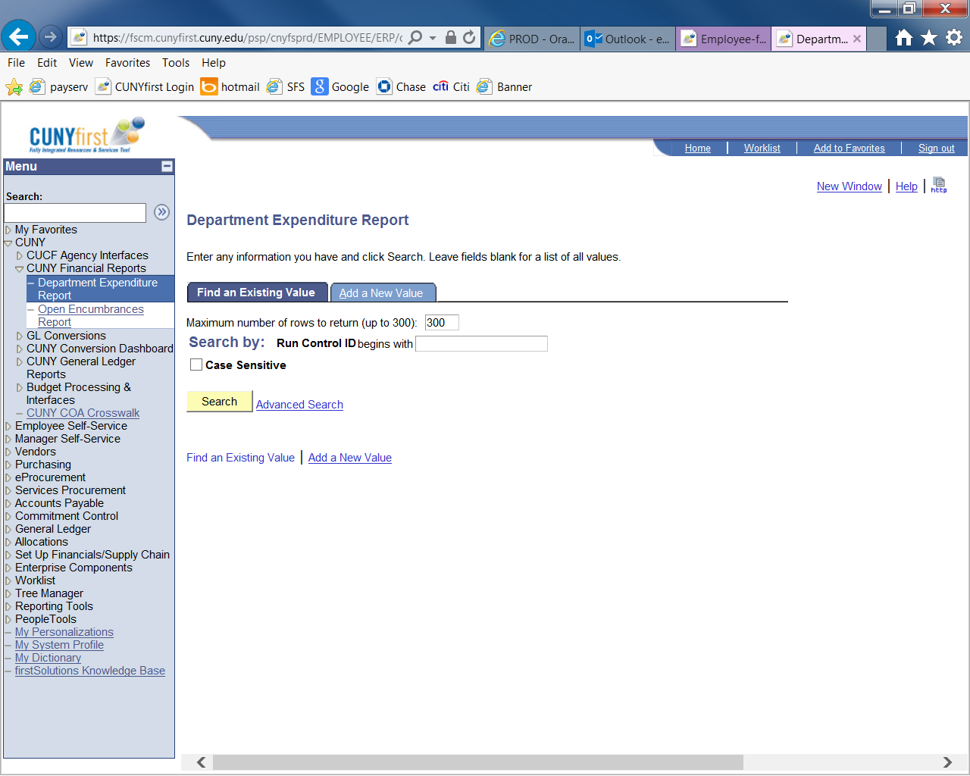
Running Department Expenditure Detail Reports
“Department Expenditure Report” screen should look like this:

Slide 4
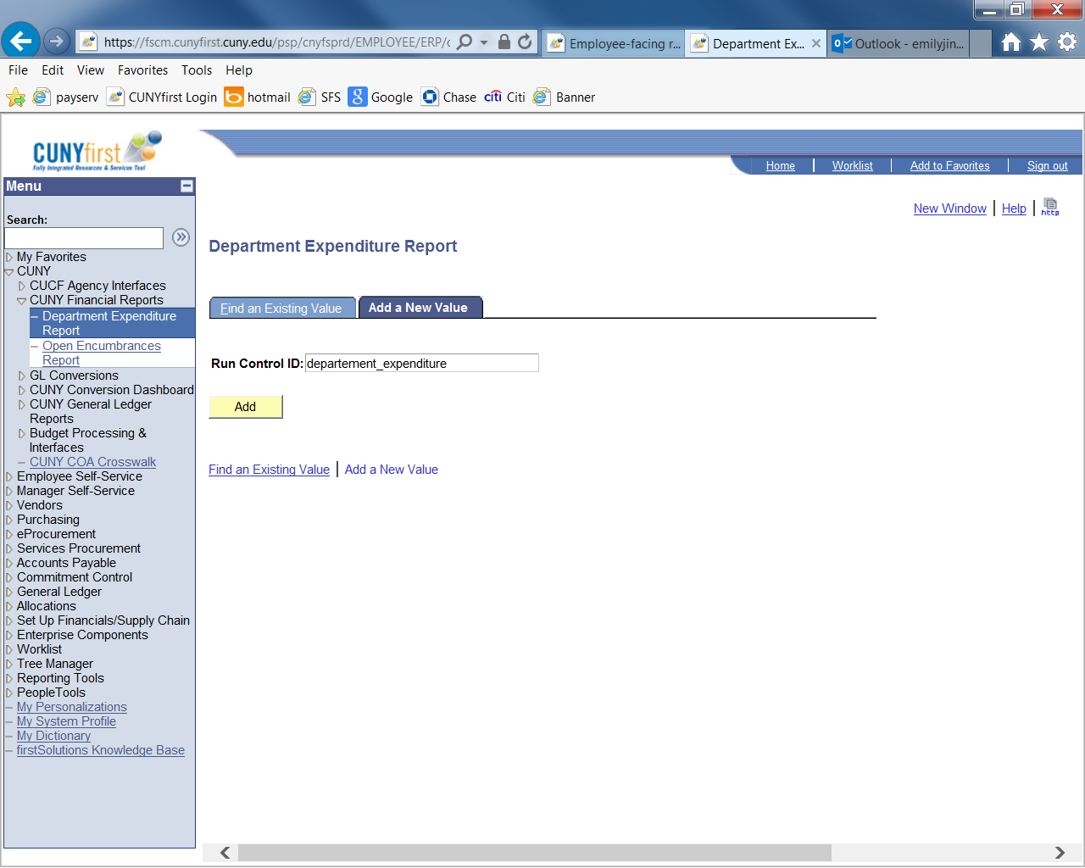
Running Department Expenditure Detail Reports
Select “Add a New Value” tab, and type “Department_Expenditure” in the Run Control ID field.
2. Select the “Add” button

Slide 5
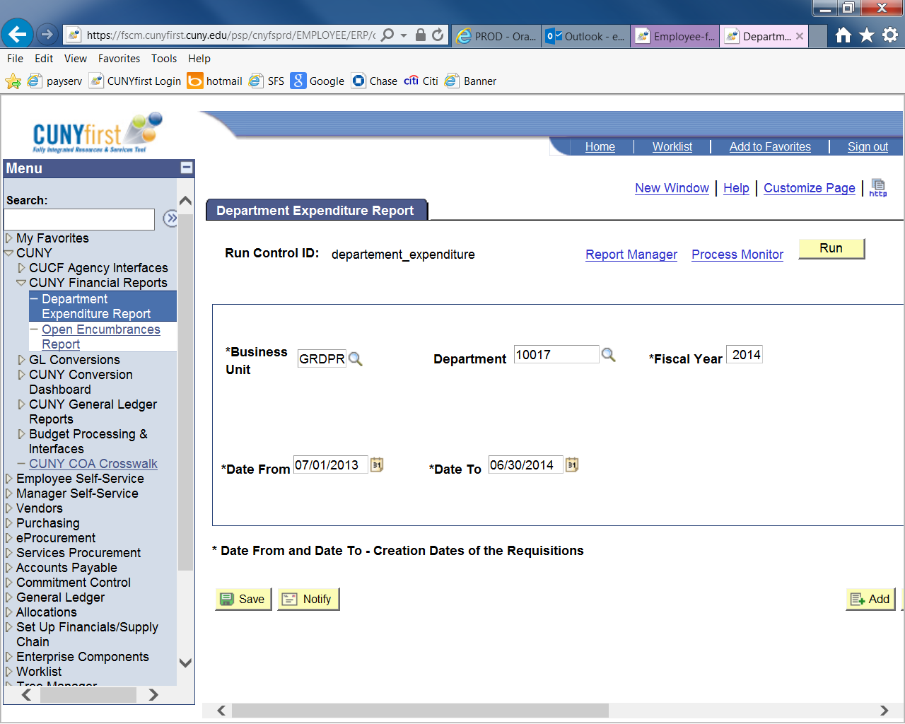
Running Department Expenditure Detail Reports
Add the following criteria ( all criteria are required)
Business Unit: YRKPR
Department code: Enter the 5 digit CUNYFIRST department code you wish to review
Fiscal Year: type (i.e. “2014”)
Date From and Date To: Use 07/01/2013-06/30/2014 for the current fiscal year
Click “Save” first
And then click “Run”
6
1
2
3
JJC01
JJC01
YRKPR
4
5

Slide 6
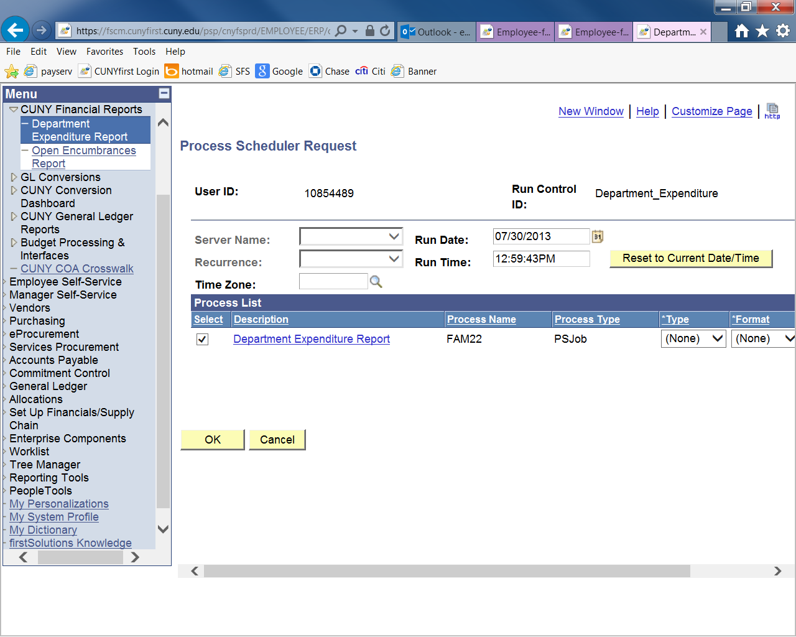
Running Department Expenditure Detail Reports
1. Make sure the box is checked.
2. Click “OK”

Slide 7
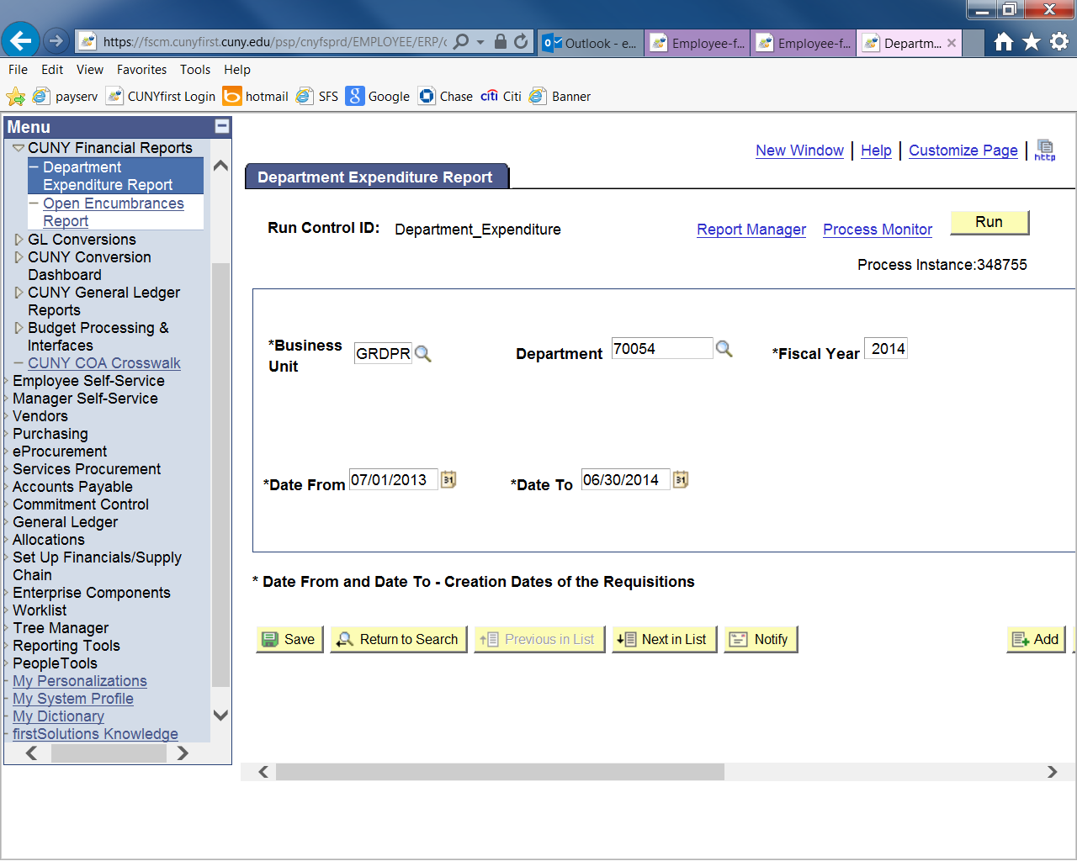
Running Department Expenditure Detail Reports
Click “Process Monitor”
YRKPR
JJC01

Slide 8
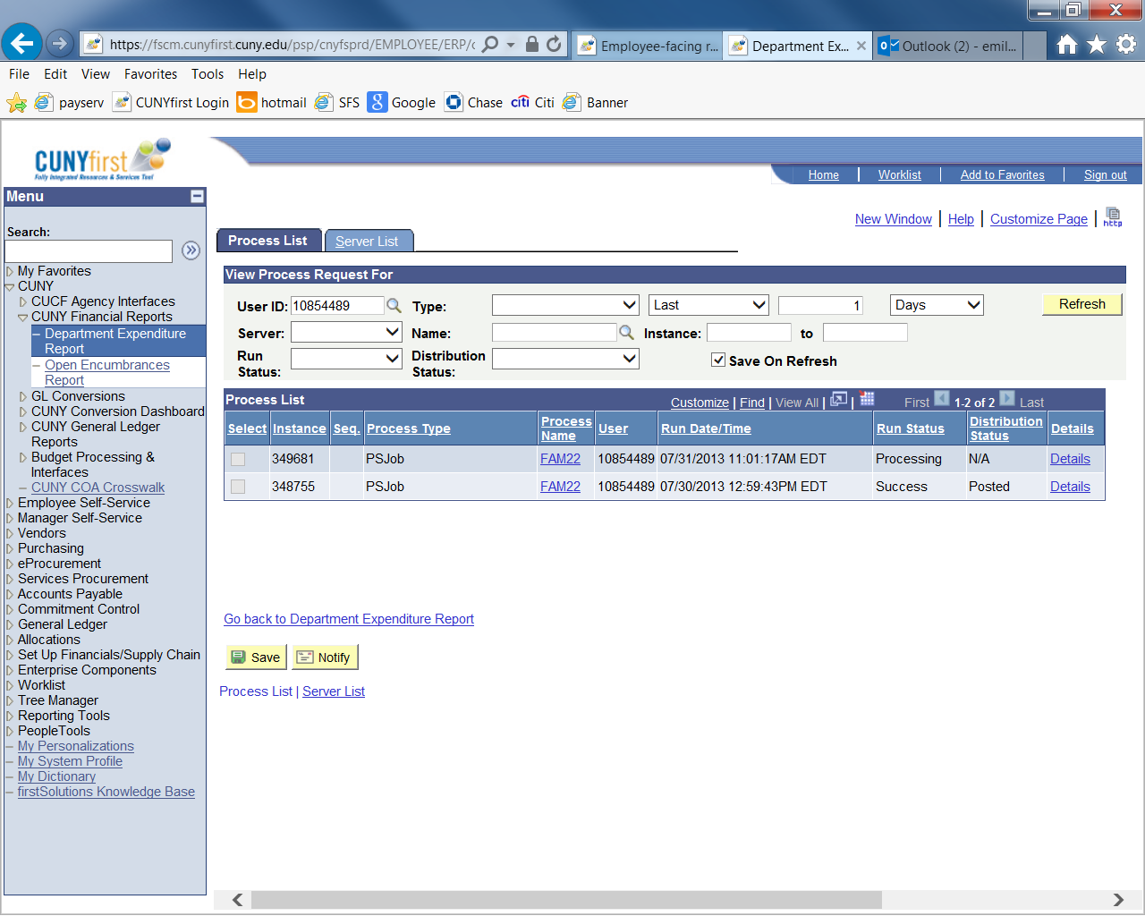
Running Department Expenditure Detail Reports
Click “Refresh” until the “Run Status” changes from “Processing” to “Success”.
(*the report will not be ready until the “Run Status” shows “Success”.
It may take a minute or two)

Slide 9
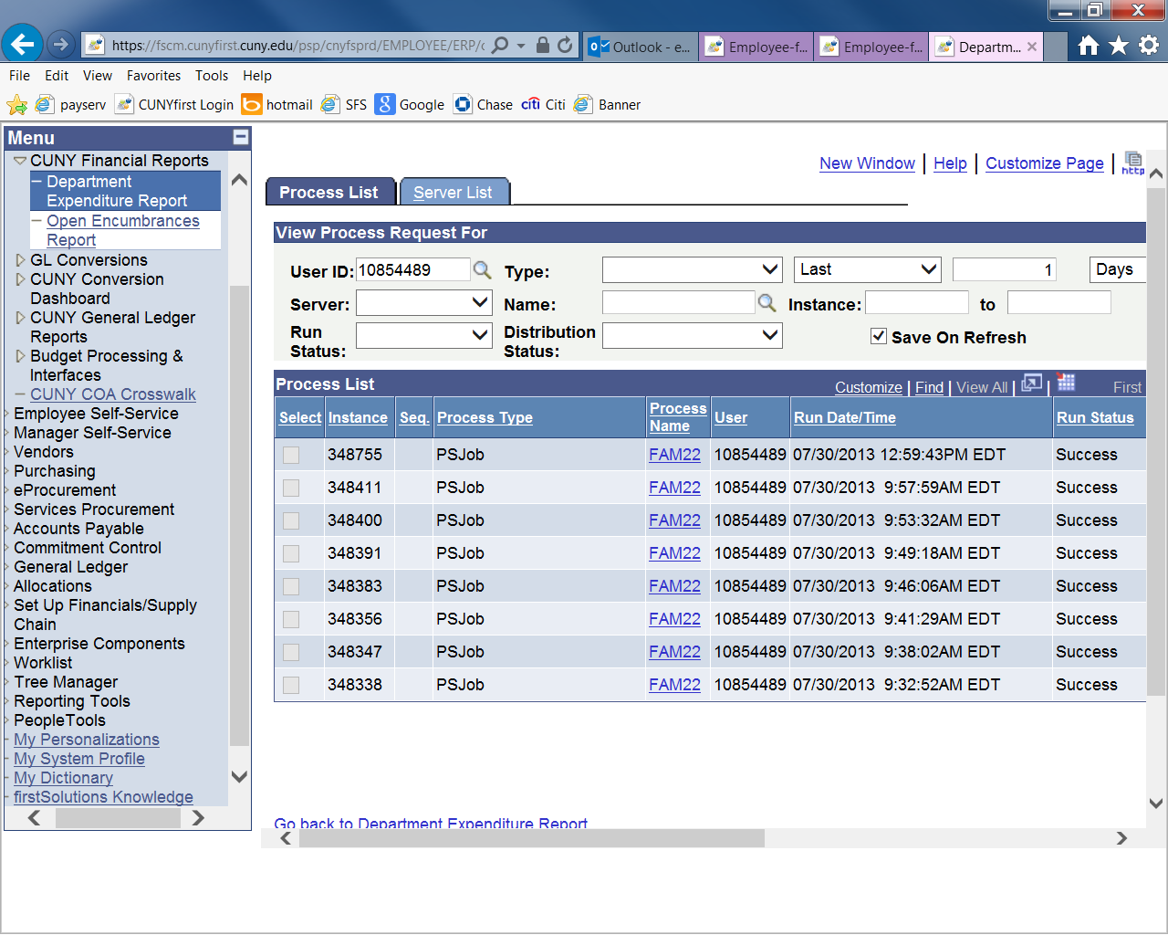
Running Department Expenditure Detail Reports
Click the most recent “Success” “FAM22” link which appears on the top of the list.

Slide 10
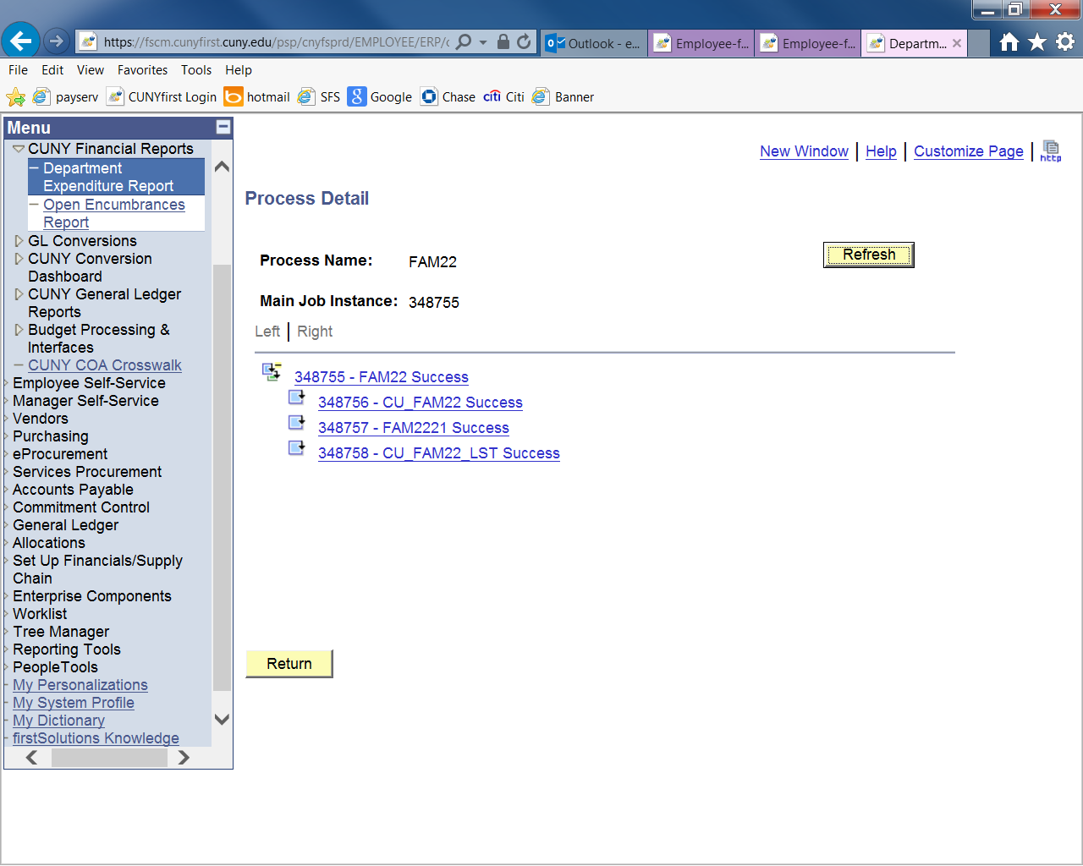
Running Department Expenditure Detail Reports
Click
“FAM2221 Success” link

Slide 11
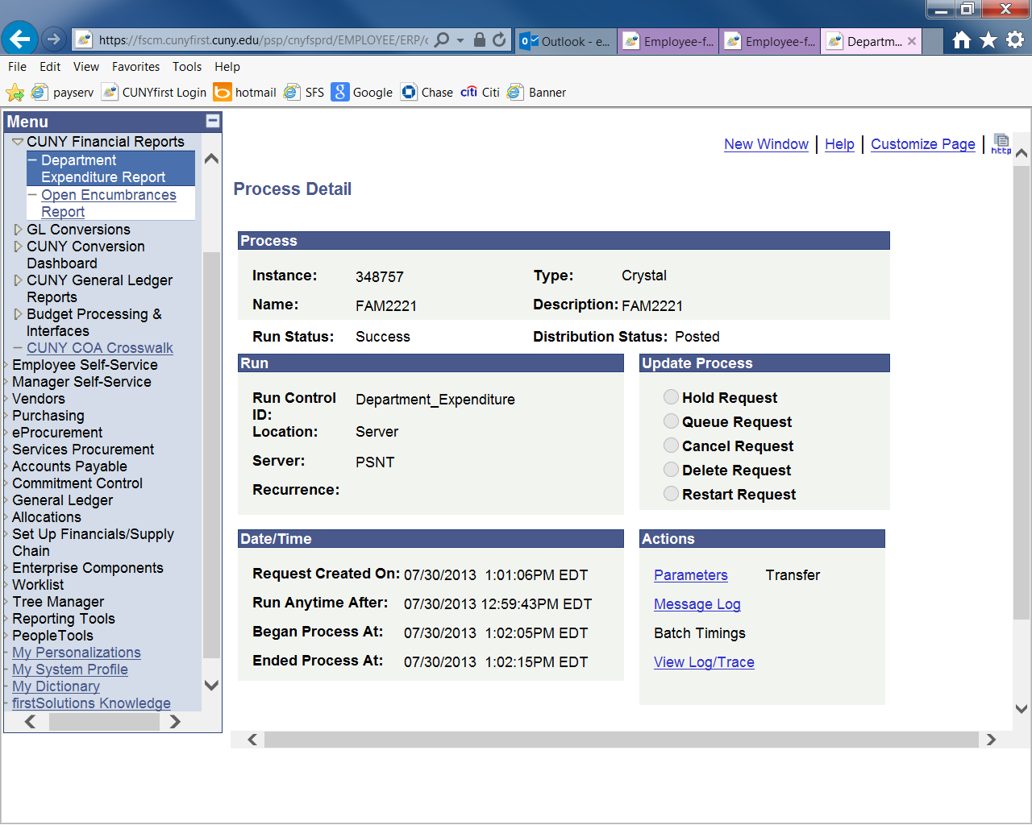
Running Department Expenditure Detail Reports
Click “View log/Trace” link

Slide 12
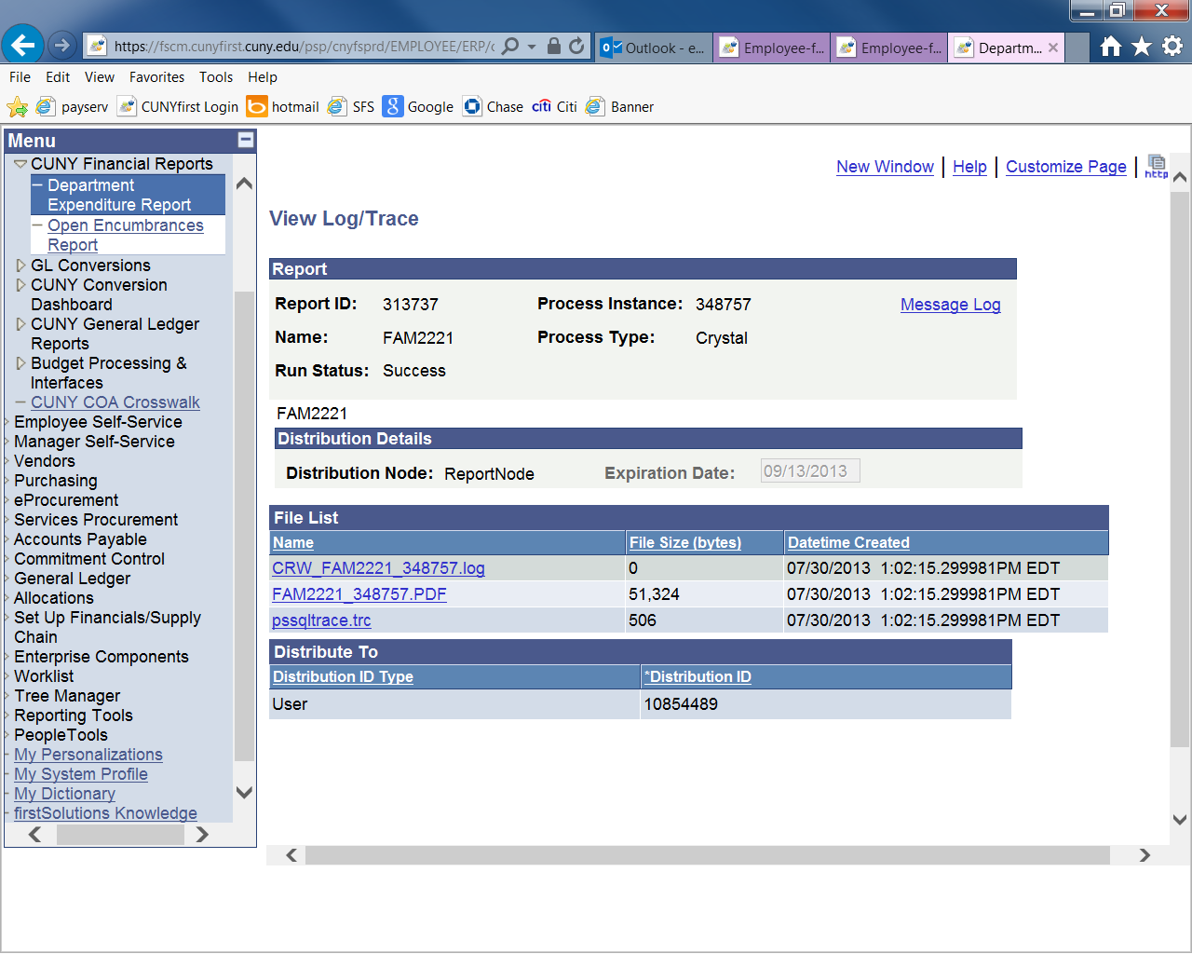
Running Department Expenditure Detail Reports
Click the PDF link

Slide 13
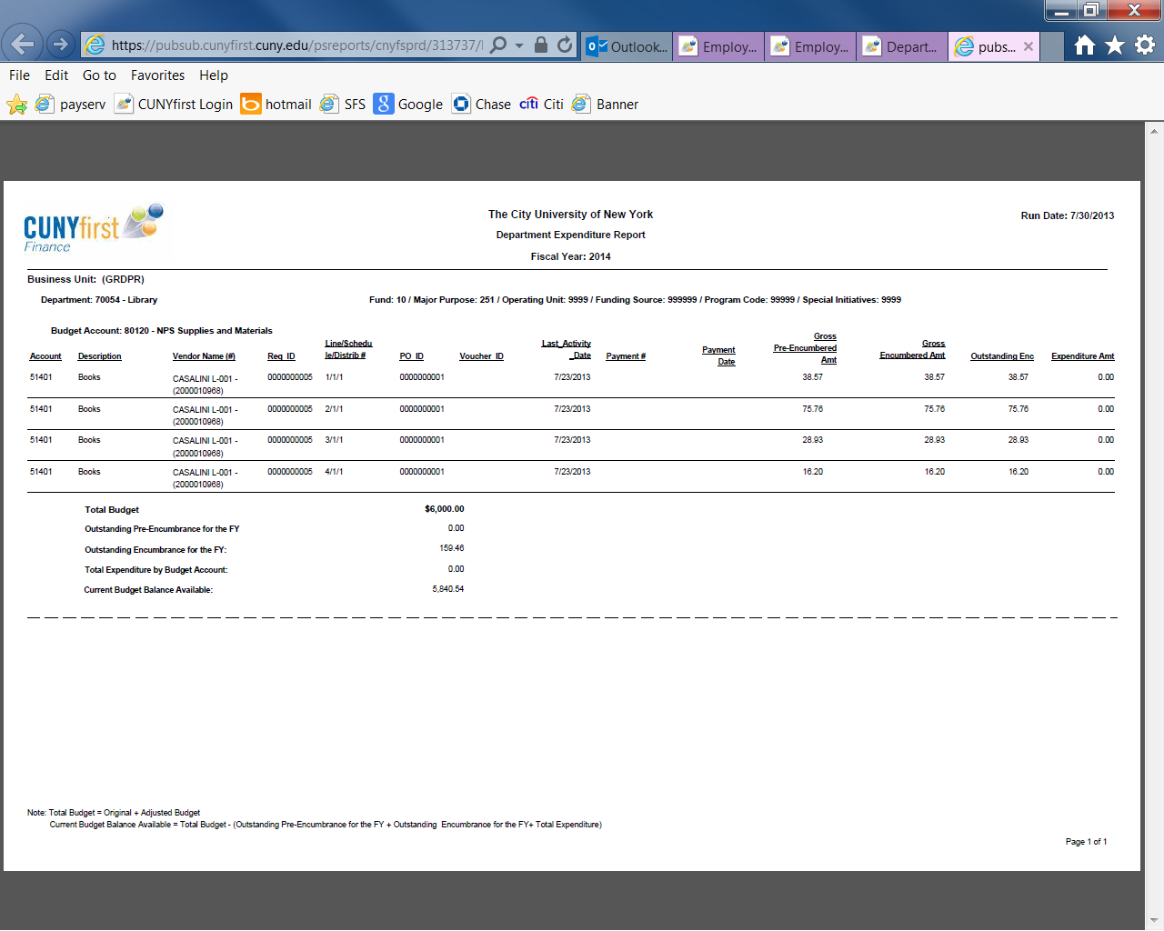
Running Department Expenditure Detail Reports
This report shows current budget and current expenses. If there is no expense in the account, there is no detail information for this account in the report.
YRKPR

