Slide 1
Blackboard Course Setup in 12

Slide 2
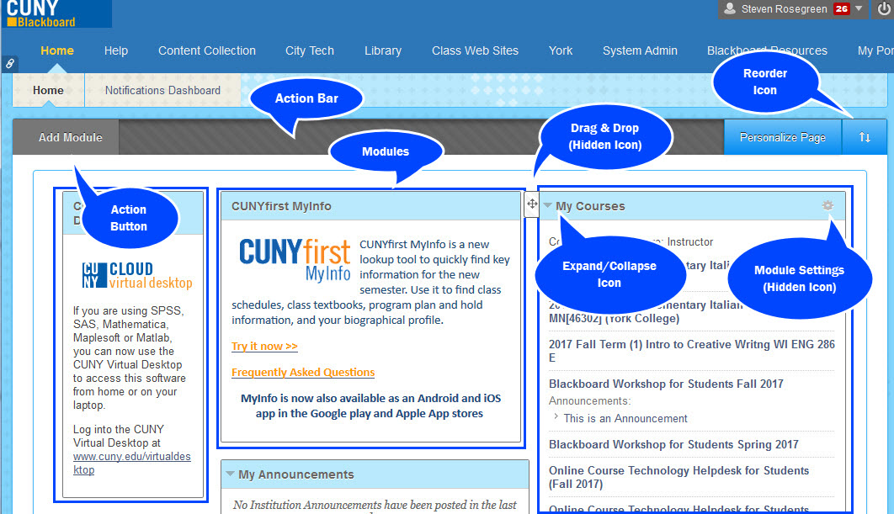
1.2 Setting up the Bb Home Page

Slide 3
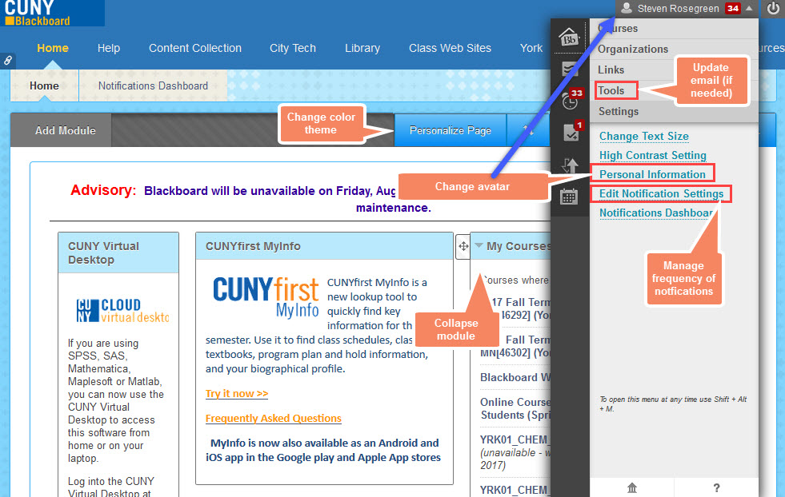
The Bb Home Page (cont’d)

Slide 4
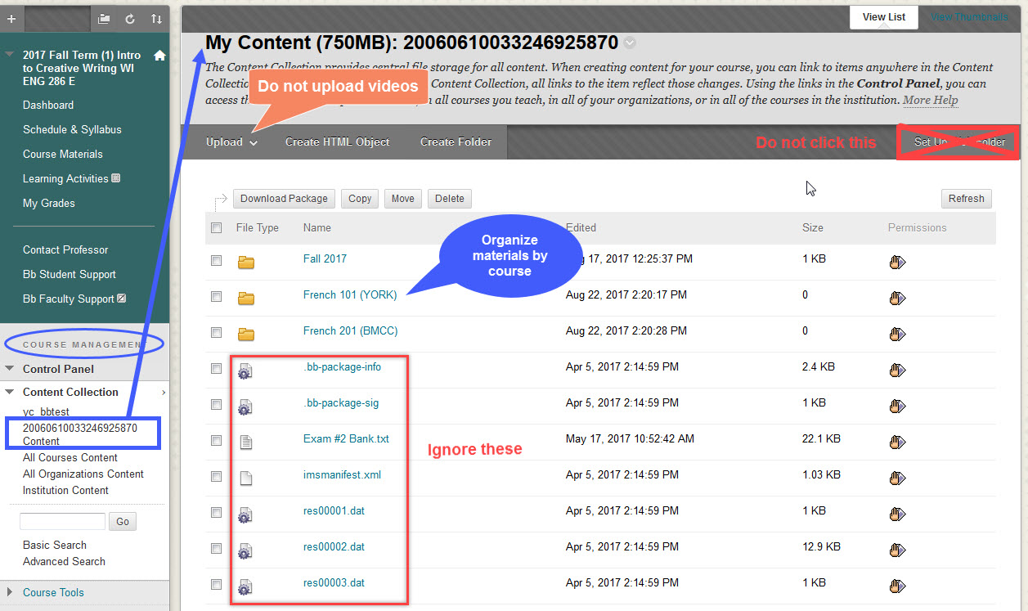
1.3 “Prepping” in the Course Management section 1.3.1 Organizing your drive and uploading your syllabus

Slide 5
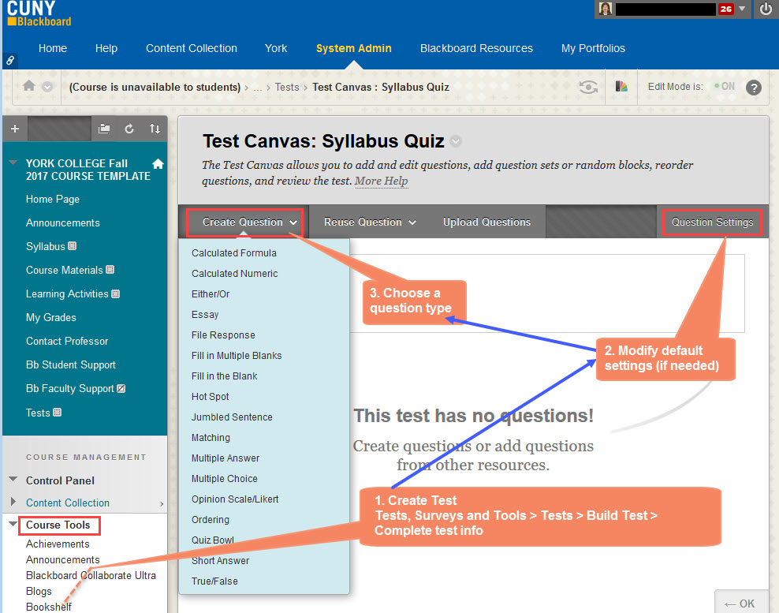
1.3.2 Setting up a Syllabus Quiz

Slide 6
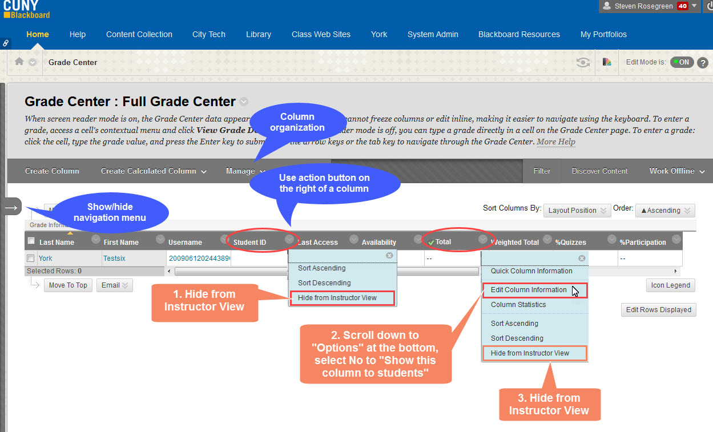
1.3.3 Setting up the Grade Center 1.3.3.1 Simplifying the default Grade Center

Slide 7
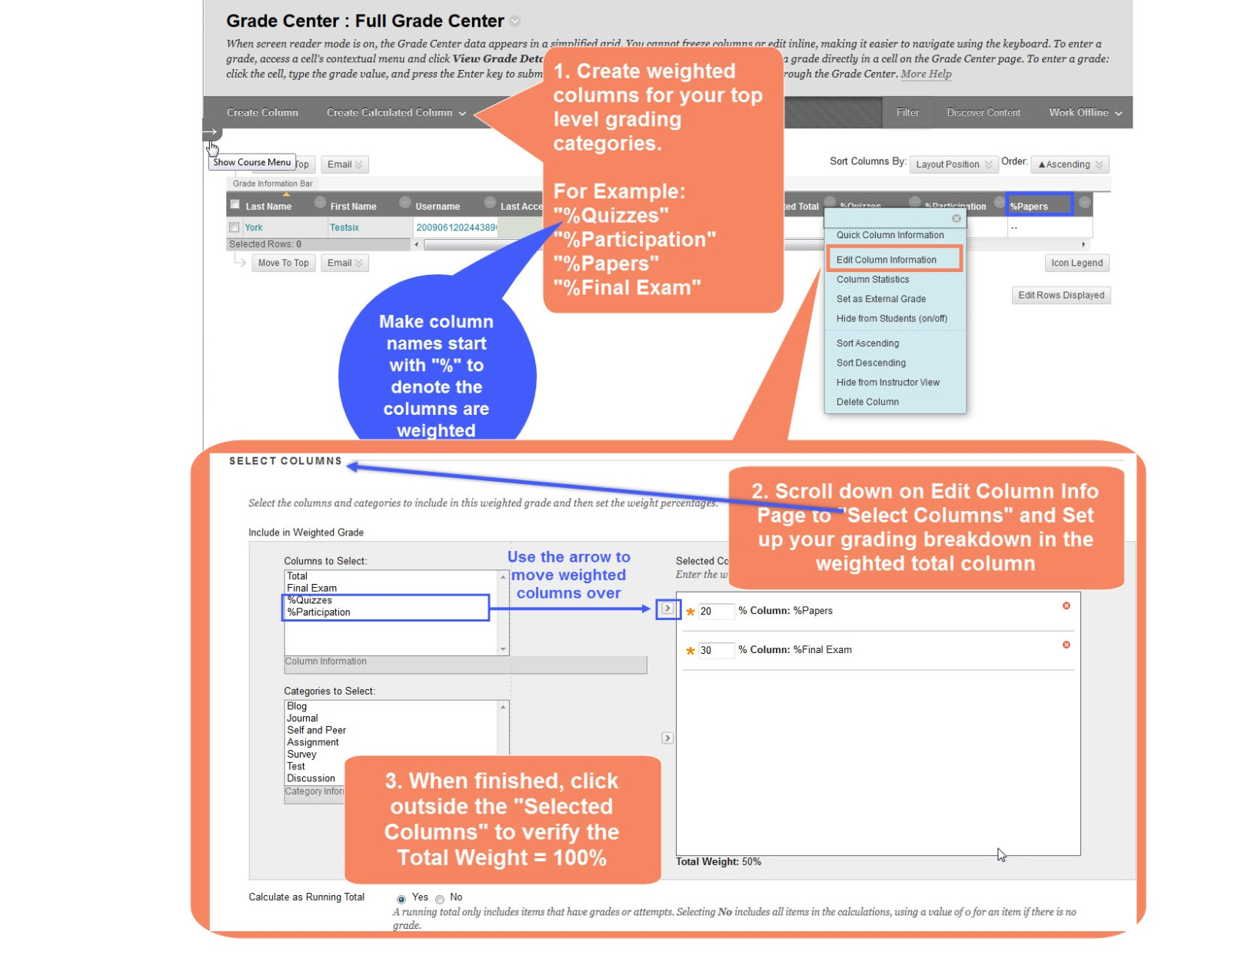
1.3.3.2 Your Grading Breakdown

Slide 8
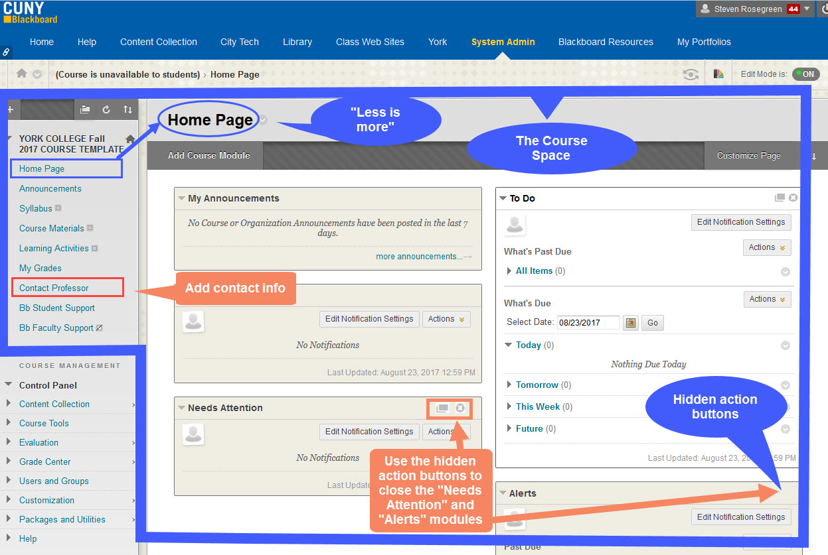
1.4 Designing your course learning space 1.4.1 The Course Learning Space 1.4.2 Editing Contact Prof. page and turning the Home page into a Dashboard

Slide 9
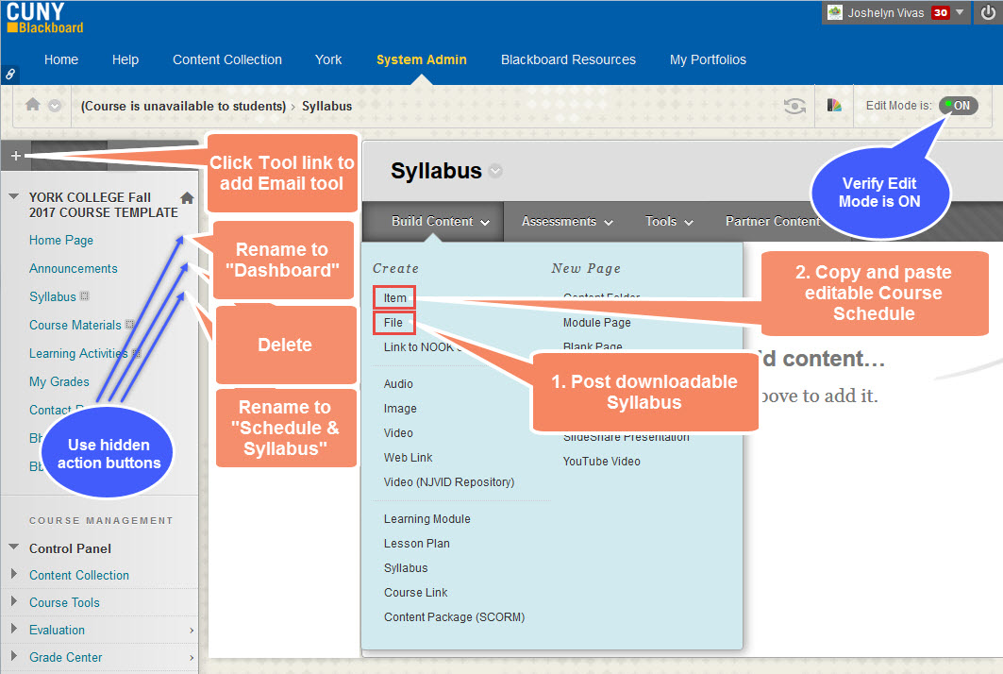
1.4.3a Making Learning Materials available; making your syllabus available for download and creating your course schedule

Slide 10
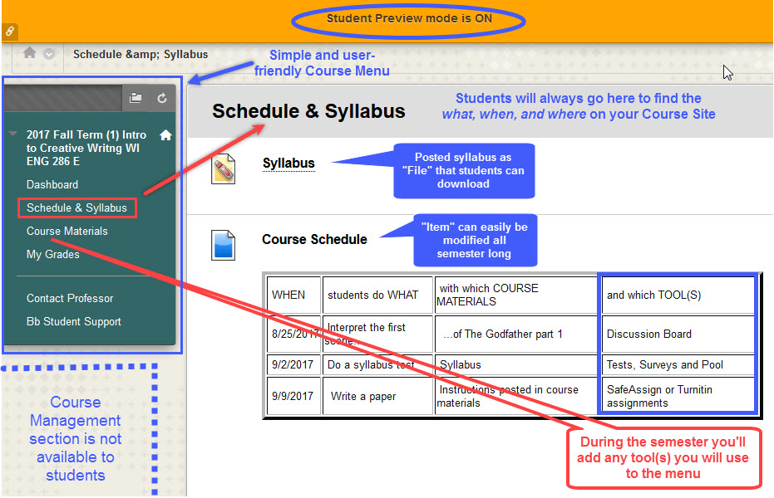
1.4.3b - A student view

Slide 11
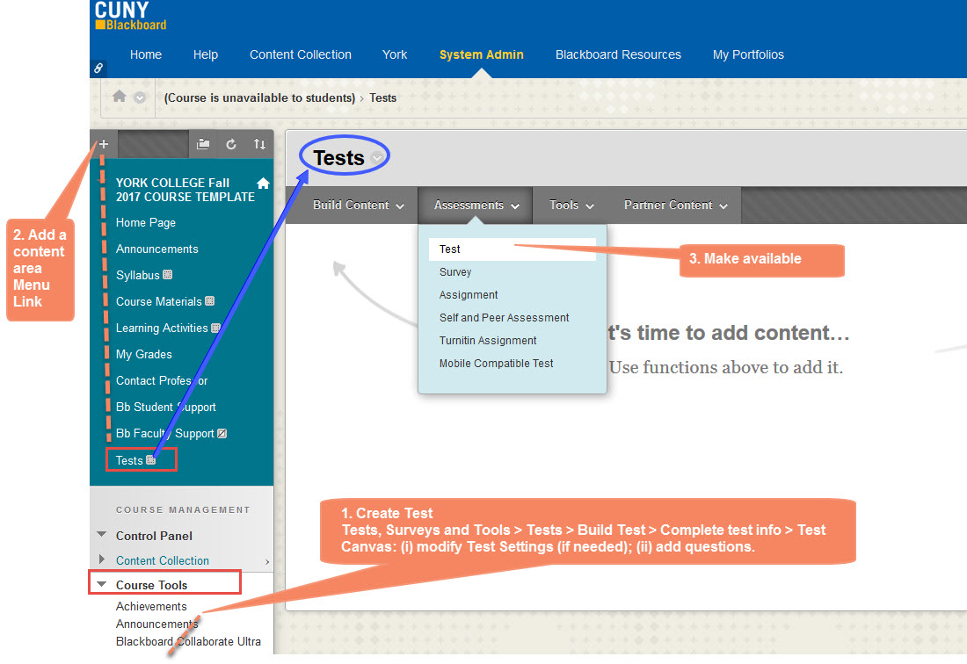
1.4.4 Adding and deleting menu links to tools and content areas; reordering links

Slide 12
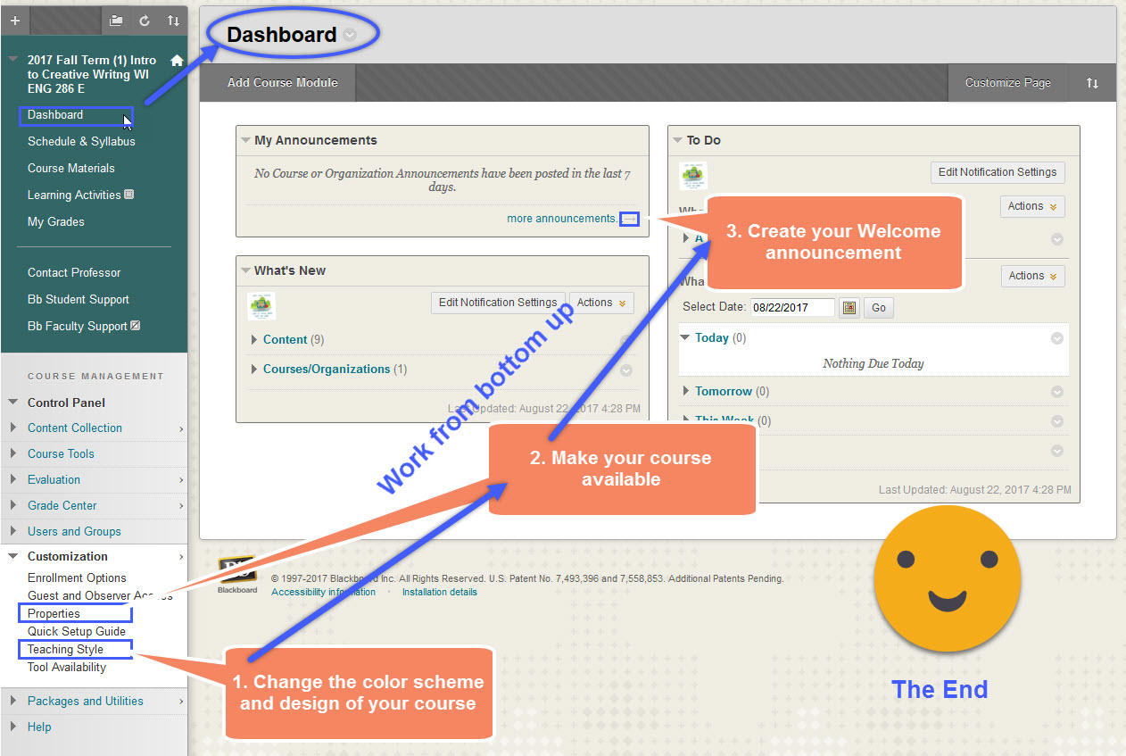
1.5 Changing the looks of your course, making your course available, and sending a welcome announcement

