Slide 1

Senate Plenary
December, 10th 2024

Slide 2
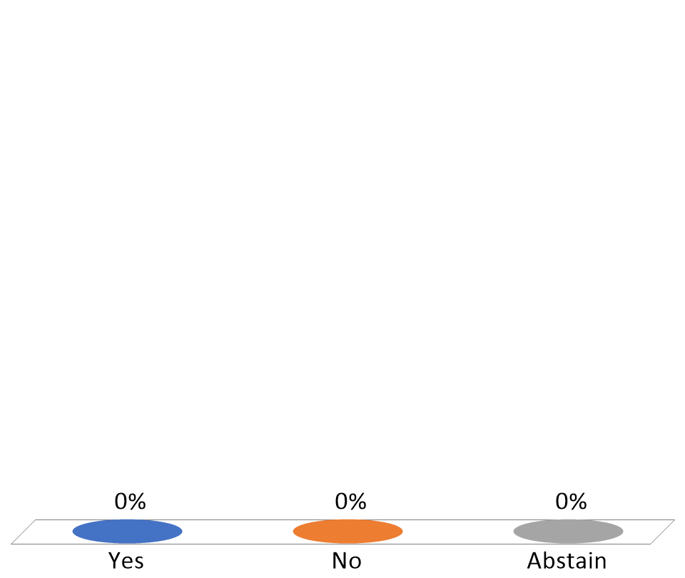
Vote in favor of Minutes for November 26, 2024
Yes
No
Abstain

