Slide 1




Student Introduction to CORE ELMS

Slide 2
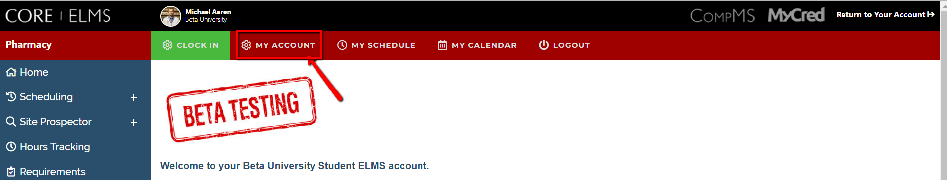
Account Registration
Expect an account activation email with your initial username and password from
no-reply@corehighered.com
  You may want to add this email to your trusted email sources
  Check your spam folder to ensure that this email was not flagged as spam
Login: https://www.corehighered.com/login-elms.php
Once you have logged in you may edit your username, password and contact information by clicking on Account Information.

Slide 3
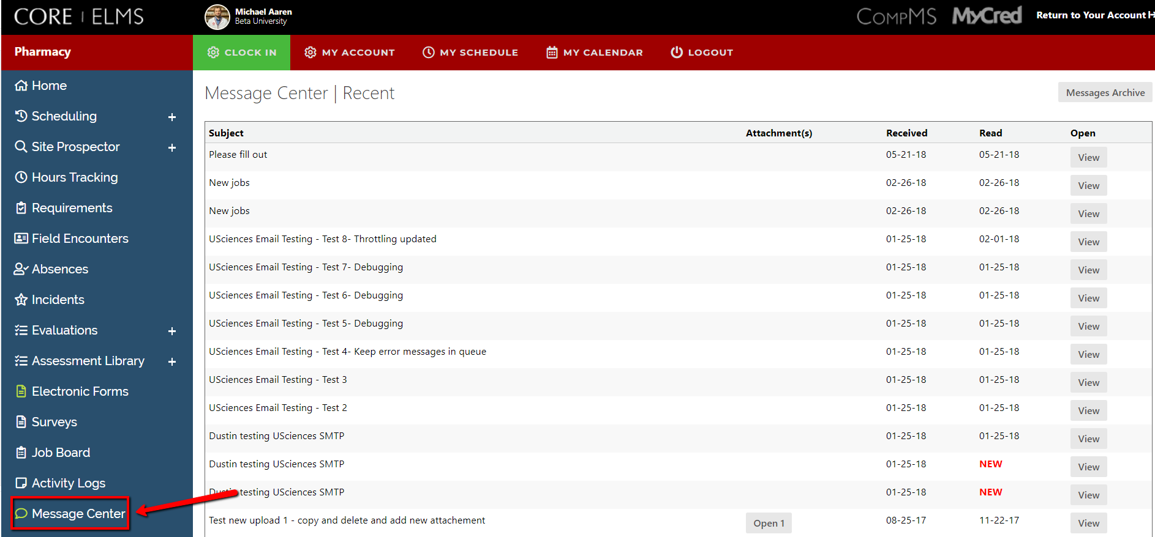
The Message Center
Read any messages that have been sent to you from your Administrator in the Message Center.

Slide 4
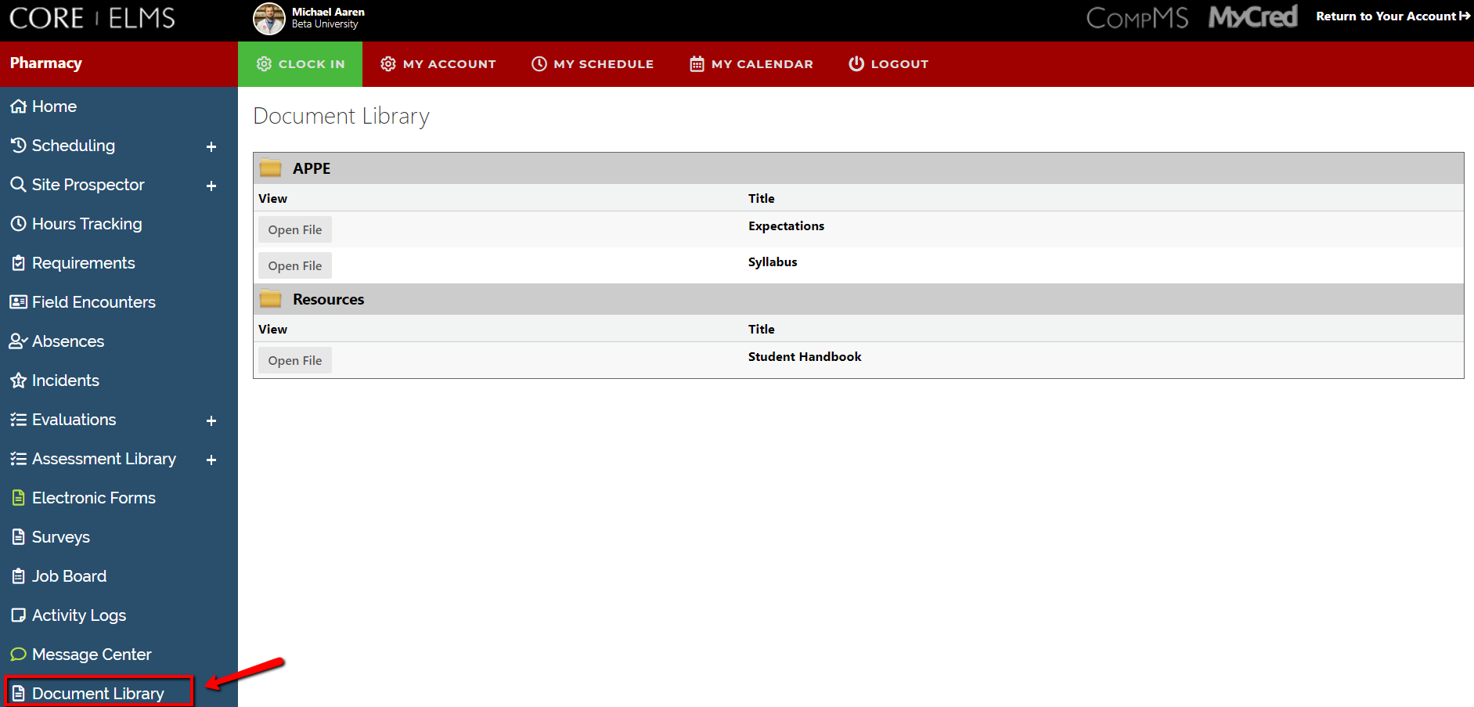
Document Library
Go through all documents and videos uploaded into your Document Library.

Slide 5
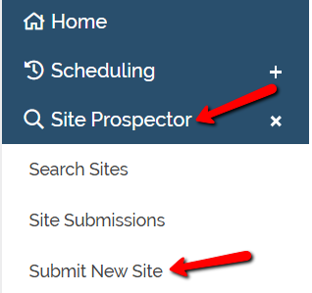
Submitting a Site
Click on Site Prospector then Submit New Site

Slide 6
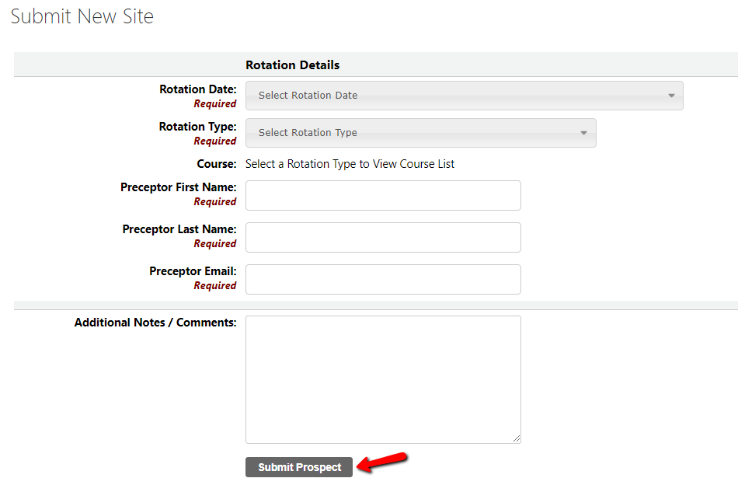
Submitting a Site
Fill out the required fields and click Submit Prospect

Slide 7
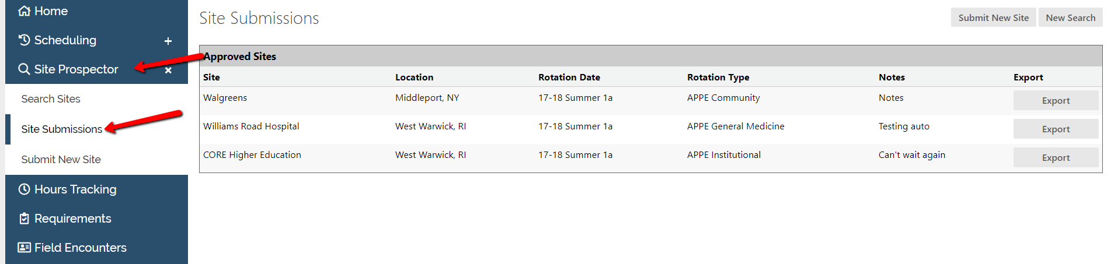
Reviewing Submissions
To review a site you have submitted, click on Site Prospector, Site Submissions
Here, you can click on Edit to make any changes or delete the submission

Slide 8
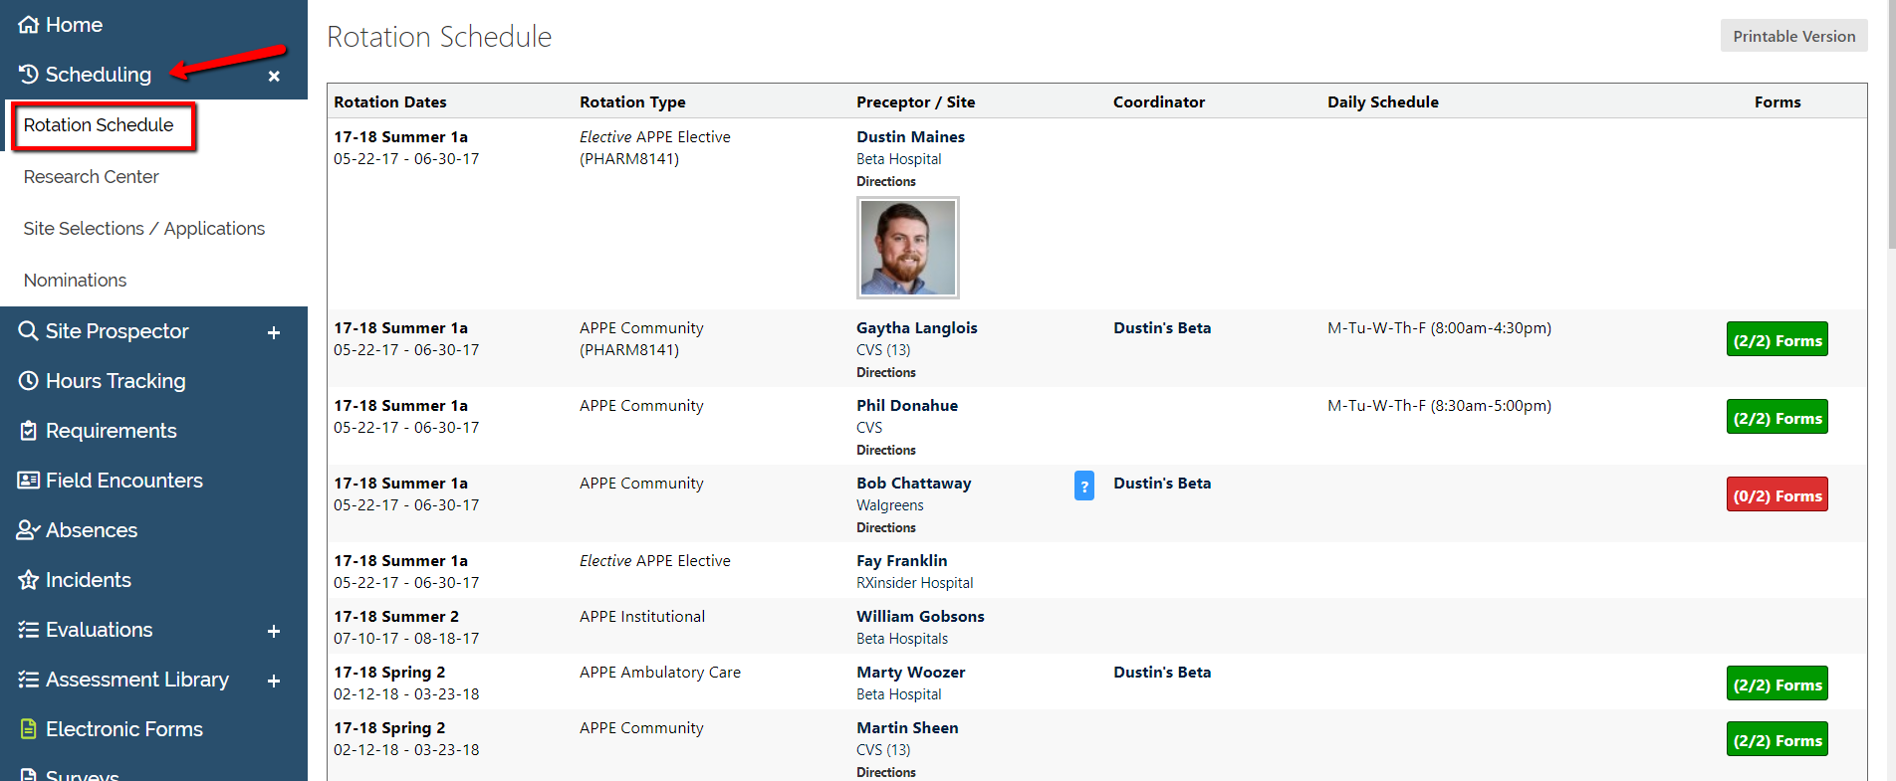
Viewing Your Schedule
Once your school has finalized and opened your schedule for viewing you may see it in your Rotation Schedule.
You will also be able to view a map of all of your Preceptor’s locations if their address was made available in the system.

Slide 9
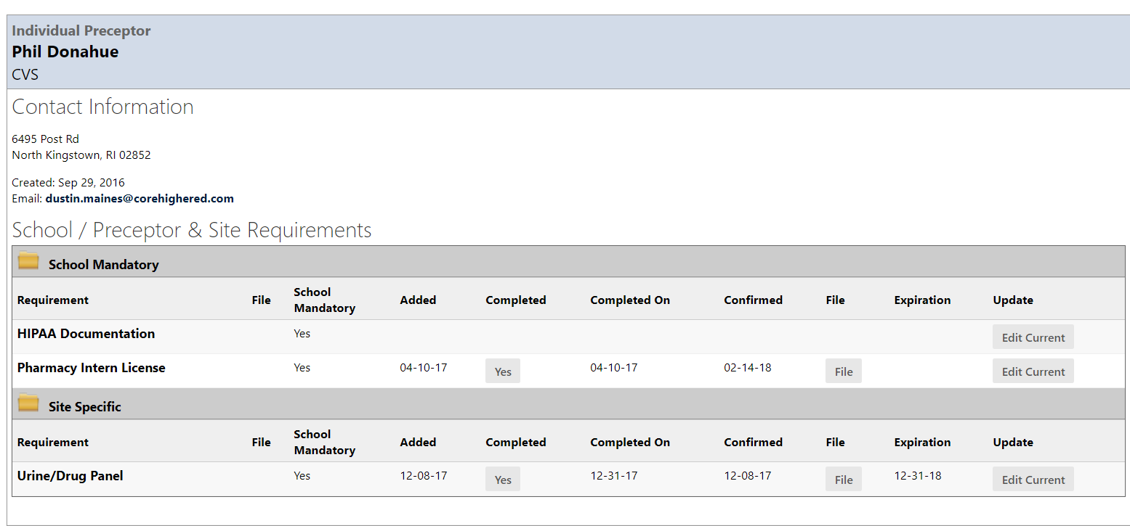
Viewing Your Schedule
Click on your Preceptor/Site name to view details such as Description, Requirements, and Documents.
You can update your site specific requirements from this page by clicking on Edit Current or Add

Slide 10
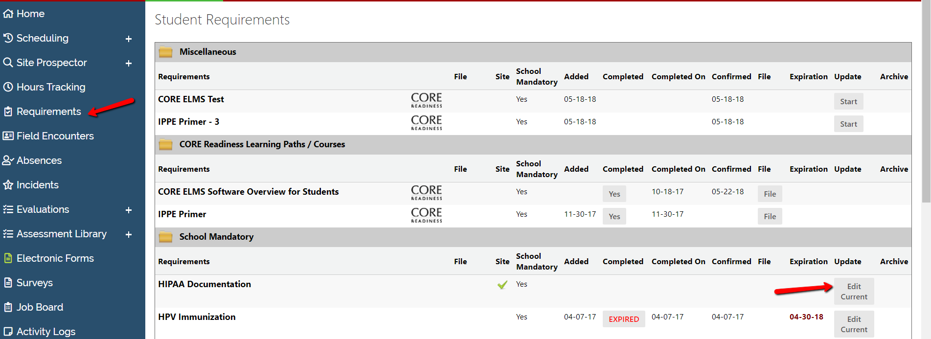
Updating Your Requirements
By clicking on the tab Requirements, you will see a full list of requirements. These will be made up of School Mandatory and Site Specific.
To update the requirement, click on Edit Current or Add.
If you would like to keep the historical data you have uploaded, click on Replace.

Slide 11
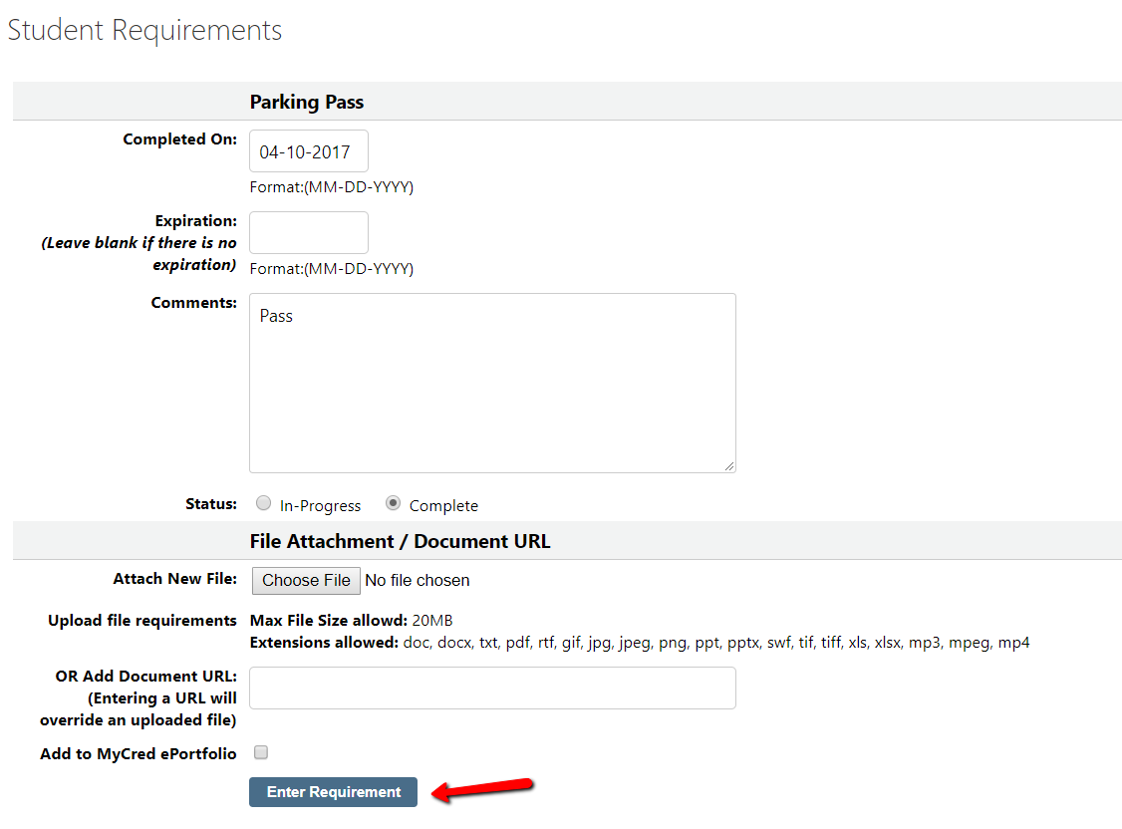
Updating Your Requirements
Once you click on Edit Current, Add or Replace, you will fill out all applicable information including Completed On, Expiration Date, Comments, Status, and Upload a File. Then click Enter Requirement to submit your information.
Please Note: Schools may also include a form to complete.

Slide 12
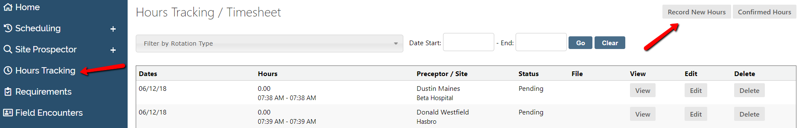
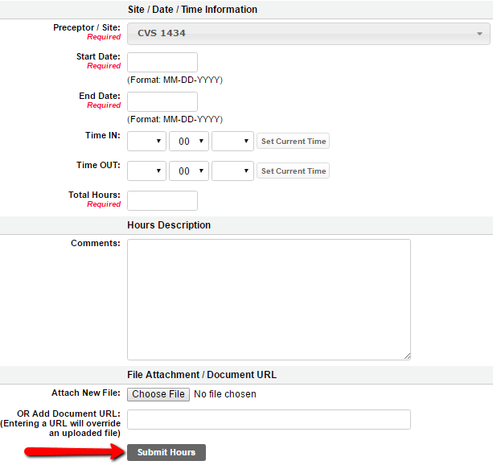
Hours Tracking / Timesheet
You can submit new hours by selecting Hours Tracking/Timesheet > Record New Hours
This will bring you to a form to submit. Fill out all fields marked as Required and click Submit Hours

Slide 13
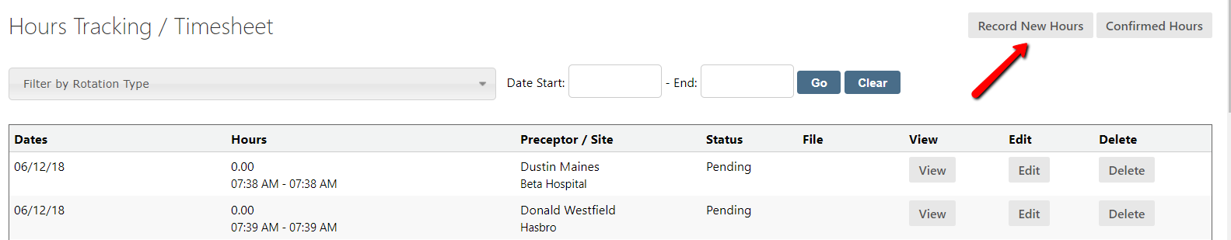
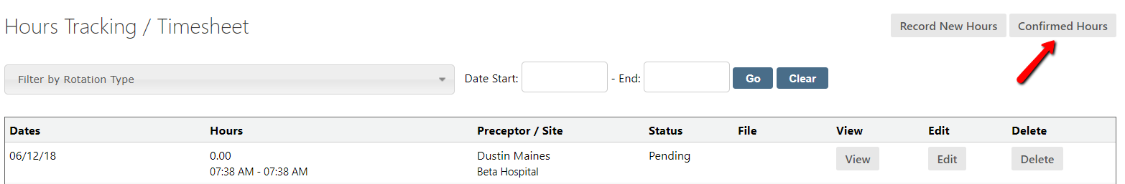
Hours Tracking / Timesheet
The Hours Tracking tab provides a means of submitting site hours (if required by your program). The page will also display for you a record of all Pending and Confirmed hours submissions.
You can switch between views by selecting “Confirmed Hours”.

Slide 14
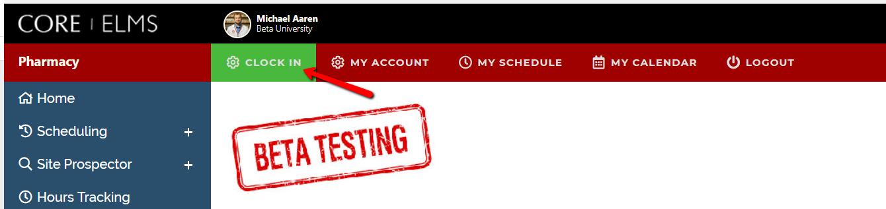
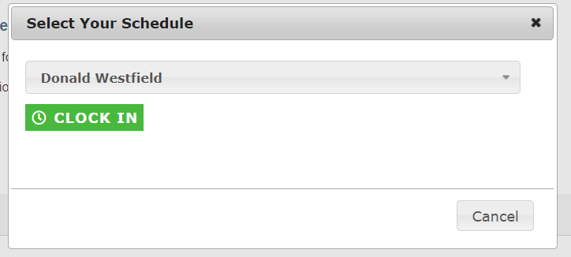
Time Clock
On the home page, click on Clock In. This will automatically capture that time and create a record.
You will then select the schedule you would like to clock into and click Clock In.

Slide 15
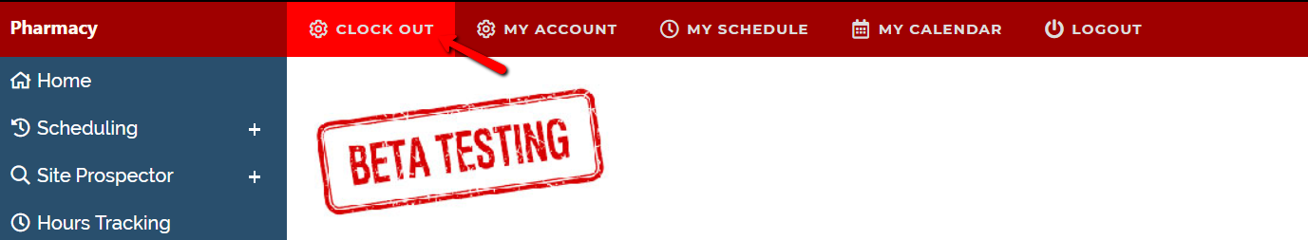
Time Clock
When your shift is done you can log back into CORE ELMS and on the home page you can click Clock Out.

Slide 16
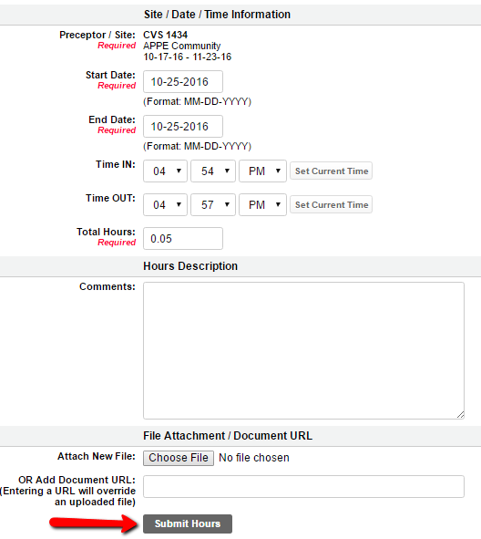
Time Clock
Next, complete all required fields and click Submit Hours. This will finalize your hours and send an email to your Preceptor/Site for confirmation.

Slide 17
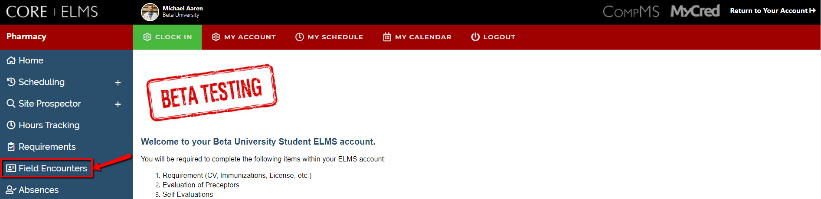
Submitting a Field Encounter
To submit a Field encounter, click Field Encounters and Add next to the appropriate Encounter.

Slide 18
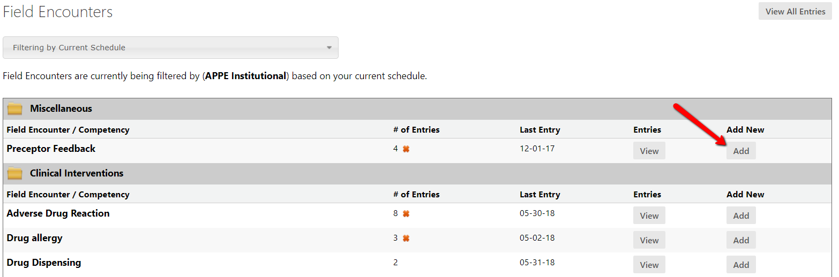
Submitting a Field Encounter
Click Add next to the appropriate Field Encounter.

Slide 19
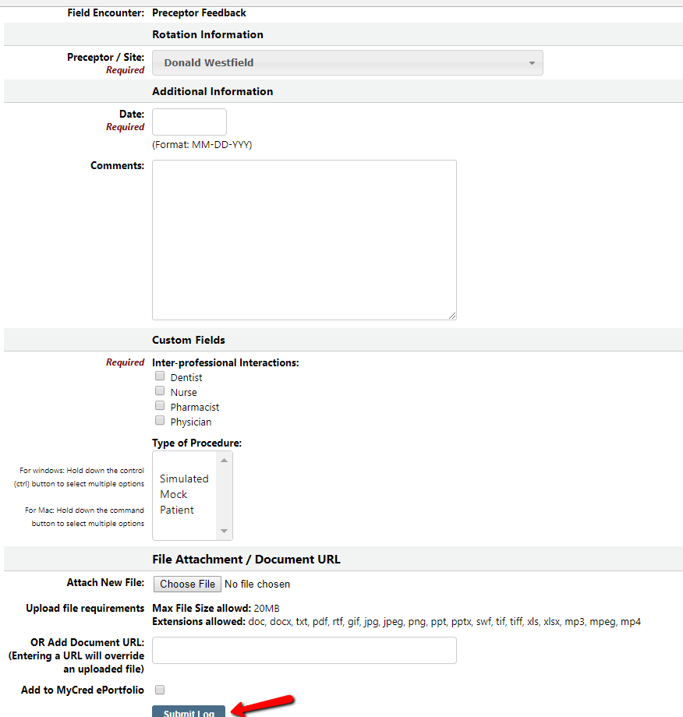
Summiting a Field Encounter
This will bring you to a new page where you will fill out all required information and click Submit Log

Slide 20
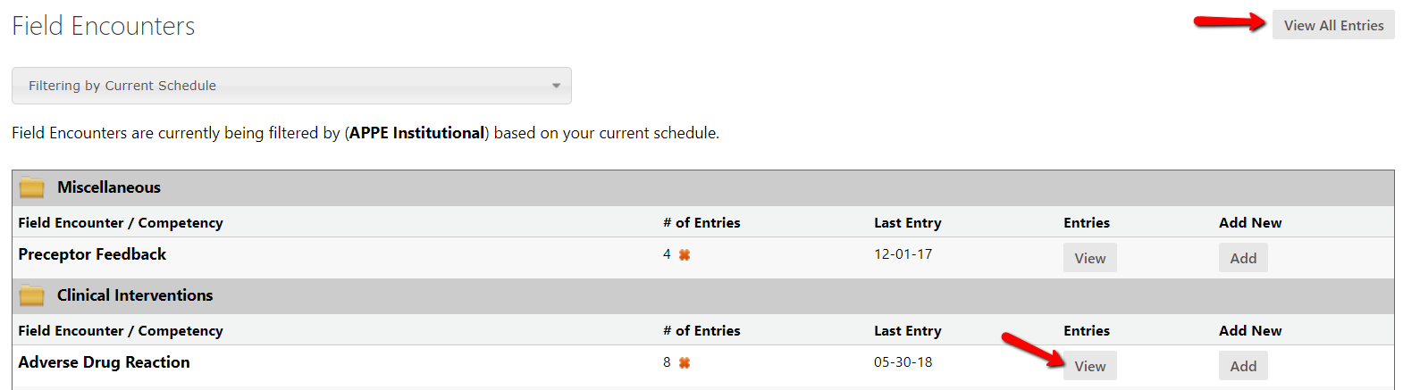
Field Encounters
To review any submitted Field Encounters, click on Field Encounters and click View next to a specific Encounter to see those entries related to that encounter.
You can also click on View All Entries to review a list of all submitted entries

Slide 21
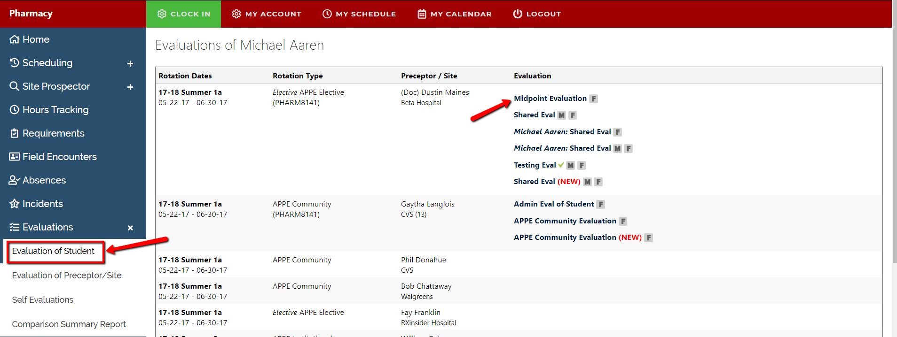
Evaluations
Once your preceptor has completed an evaluation and your school has opened it up for you to view, you will be able to view it under “Evaluation of Student”.
You can complete your Evaluation of your Preceptors/Sites under “Evaluation of Preceptors”.
If your school requires you to complete a self evaluation, it will be accessed through “Student Self Evaluation”.
    Note: You may save all evaluations in draft mode to finish at a later time by clicking “Save Changes” once you click “Submit Final” you will no longer be able to edit the evaluation.

Slide 22
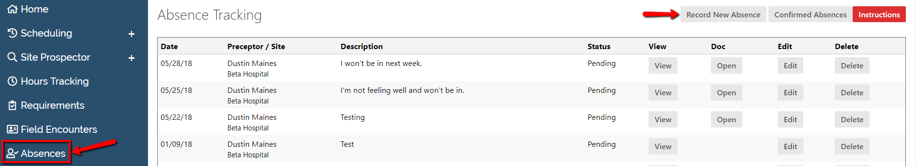
Submitting an Absence
To Submit an Absence, click Absences, Record New Absence

Slide 23
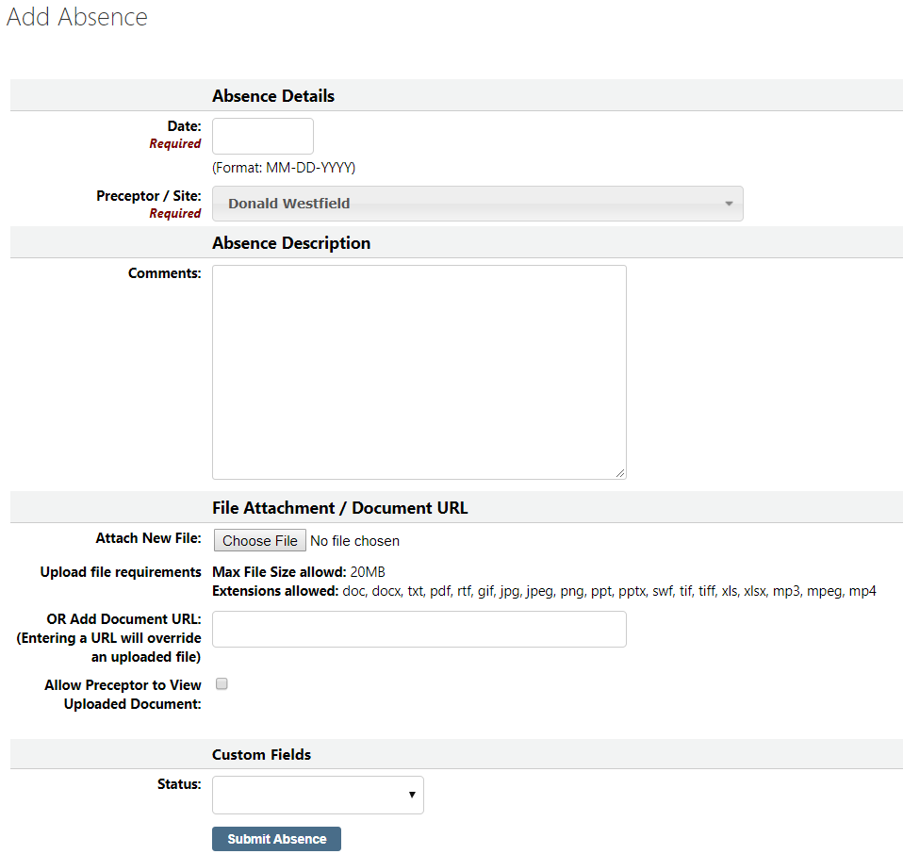
Submitting an Absence
This will bring up a new page, fill out all required fields on the form and click Submit Absence.
The selected preceptor/site will then receive an email for confirmation.

Slide 24



www.CoreHigherEd.com

